Slide 1

Student performance analysis
Deepanshi

Slide 2
Understanding data
school - student's school ('GP' or 'MS')
sex - student's sex ('F’ or 'M')
age (15 to 22)
address - 'U' - urban or 'R' - rural
famsize - family size 'LE3' - less or equal to 3 or 'GT3' - greater than 3
Pstatus - parent's cohabitation status (binary: 'T' - living together or 'A' - apart)
Medu - mother's education
Fedu - father's education
Mjob - mother's job (nominal: 'teacher', 'health' care related, civil 'services, 'at_home' or 'other')
Fjob - father's job (nominal: 'teacher', 'health' care related, civil 'services‘,'at_home' or 'other')
reason - reason to choose this school (nominal: close to 'home', school 'reputation', 'course' preference or 'other')
guardian - student's guardian (nominal: 'mother', 'father' or 'other')
traveltime - home to school travel time (numeric: 1 - <15 min., 2 - 15 to 30 min., 3 - 30 min. to 1 hour, or 4 - >1 hour)
studytime - weekly study time (numeric: 1 - <2 hours, 2 - 2 to 5 hours, 3 - 5 to 10 hours, or 4 - >10 hours)
failures - number of past class failures (numeric: n if 1<=n<3, else 4)
schoolsup - extra educational support (binary: yes or no)
famsup - family educational support (binary: yes or no)
paid - extra paid classes within the course subject (Math or Portuguese) (binary: yes or no)¶
activities - extra-curricular activities (binary: yes or no)
nursery - attended nursery school (binary: yes or no)
higher - wants to take higher education (binary: yes or no)
internet - Internet access at home (binary: yes or no)
romantic - with a romantic relationship (binary: yes or no)
famrel - quality of family relationships (numeric: from 1 - very bad to 5 - excellent)
freetime - free time after school (numeric: from 1 - very low to 5 - very high)
goout - going out with friends (numeric: from 1 - very low to 5 - very high)
Dalc - workday alcohol consumption (numeric: from 1 - very low to 5 - very high)
Walc - weekend alcohol consumption (numeric: from 1 - very low to 5 - very high)¶
health - current health status (numeric: from 1 - very bad to 5 - very good)¶
absences - number of school absences (numeric: from 0 to 93) these grades are related with the course subject, portuguese:
G1 - first period grade (numeric: from 0 to 20)
G2 - second period grade (numeric: from 0 to 20)
G3 - final grade (numeric: from 0 to 20, output target)

Slide 3
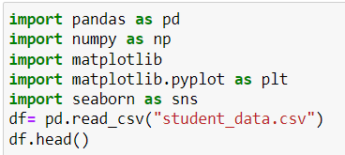
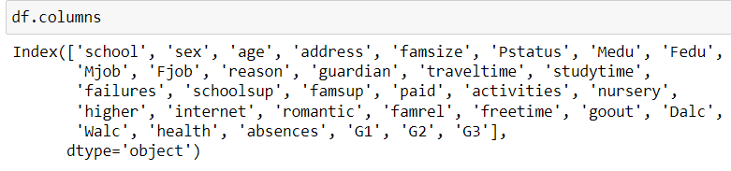
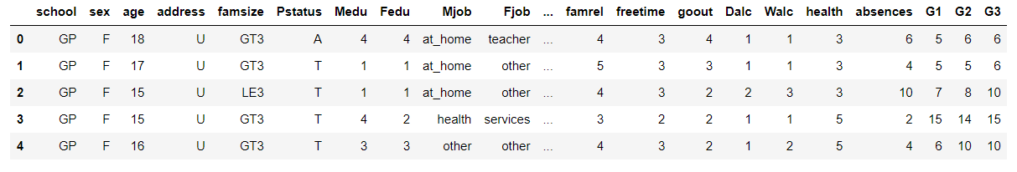
Data Exploration
Reading data using pandas
Checking size, rows and columns of dataset.

Slide 4
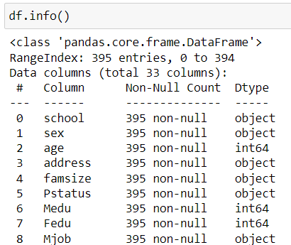
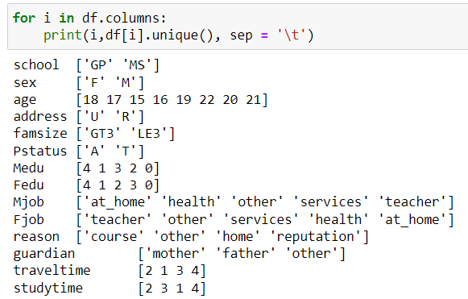
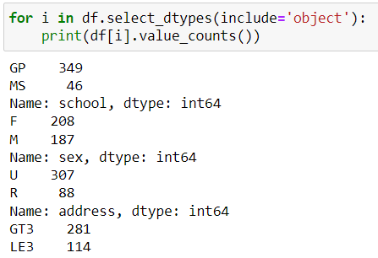
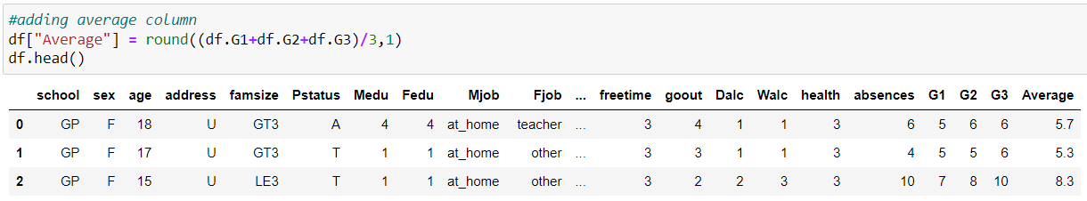
Checking datatypes of each column.
Display unique column variables and their value_numbers.
Adding a new column of average marks.

Slide 5
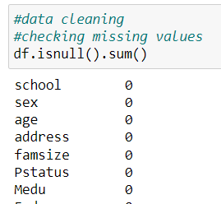
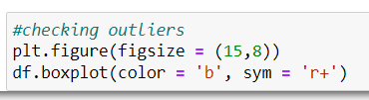
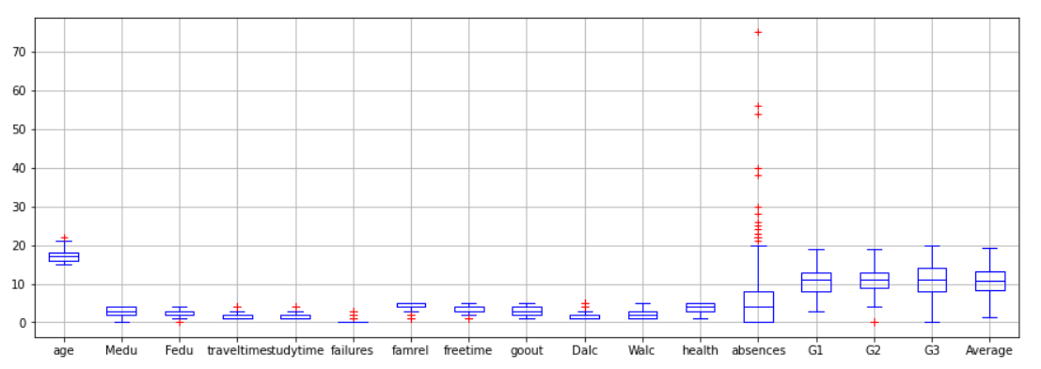
Data Cleaning
Checking for missing values
Checking for outliers
Finding IQR

Slide 6
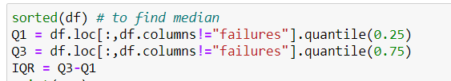
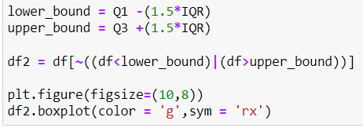
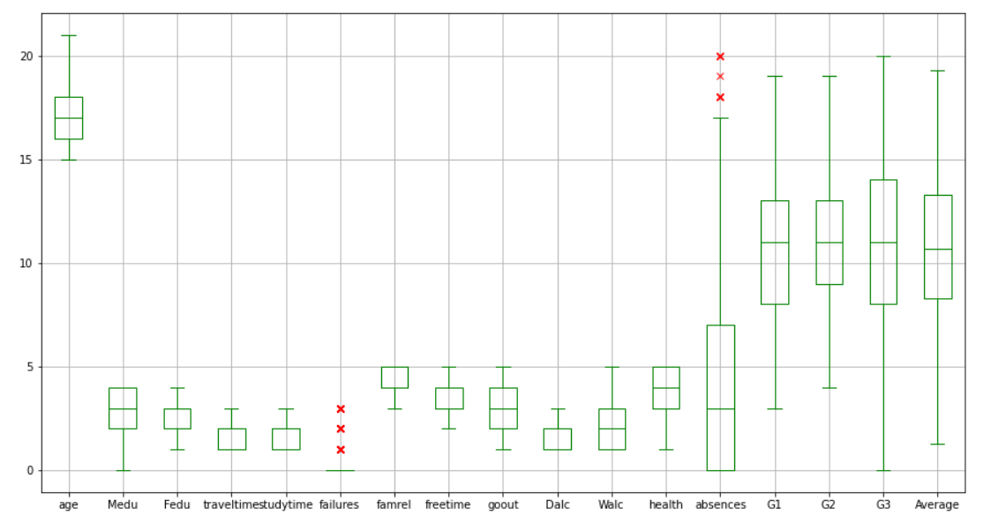

Slide 7
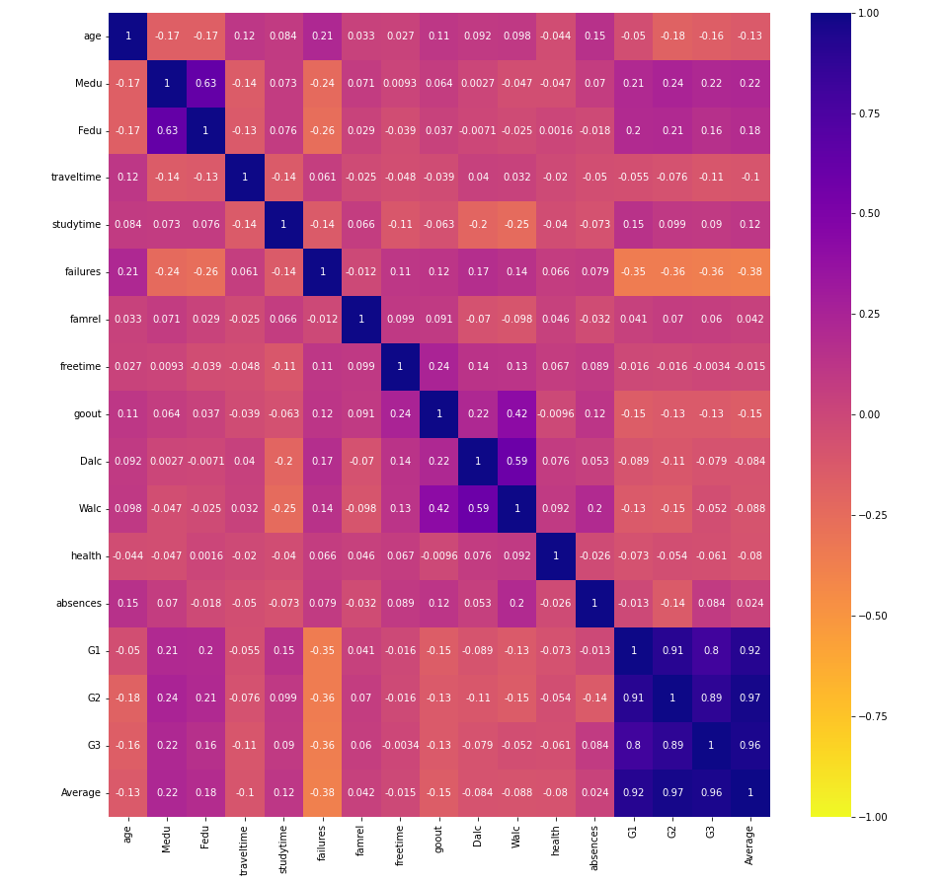
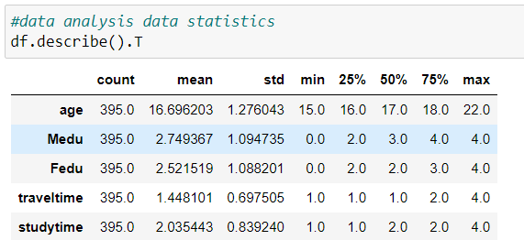

Data Analysis
Describe data
Visualizing correlation

Slide 8
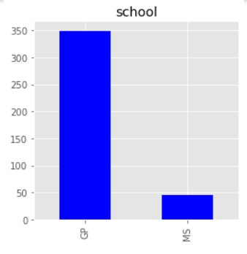
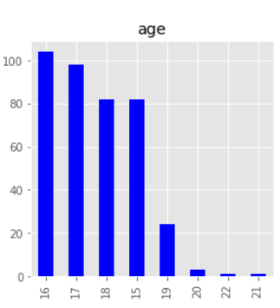
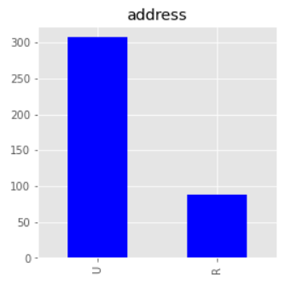
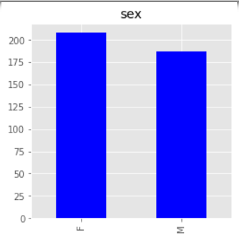
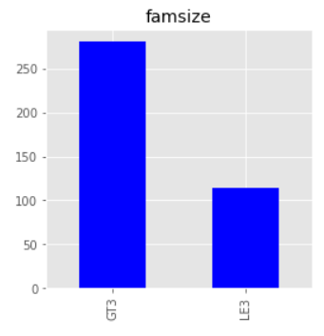
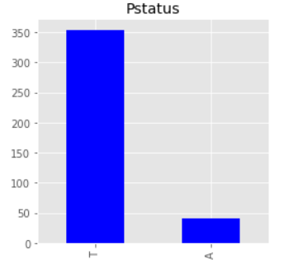
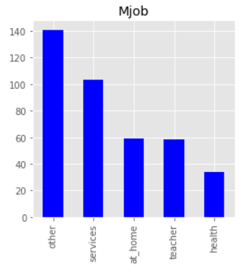
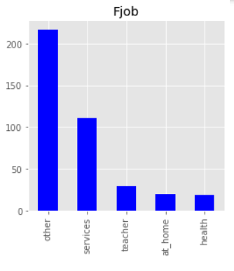
Visualize whole dataset

Slide 9
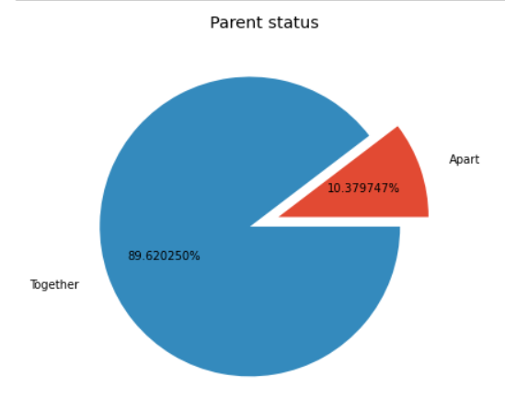
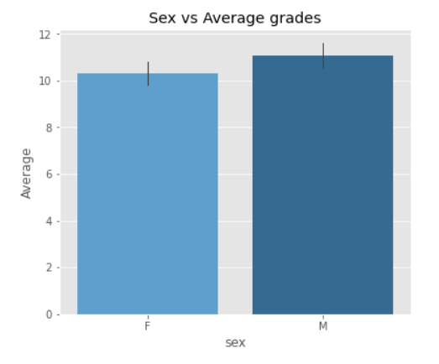
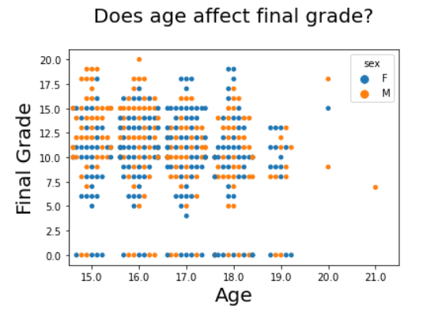
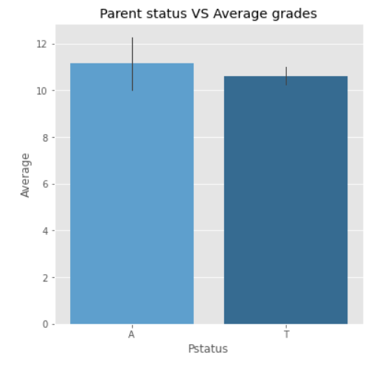
Sex vs Average marks – No effect
Does age affect final grades?
there seems to be no clear relation of age or gender with final grade
Parent status vs Average marks

Slide 10
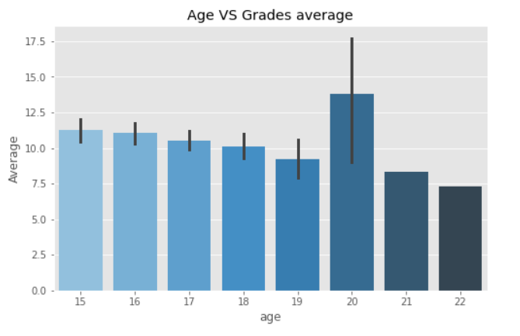
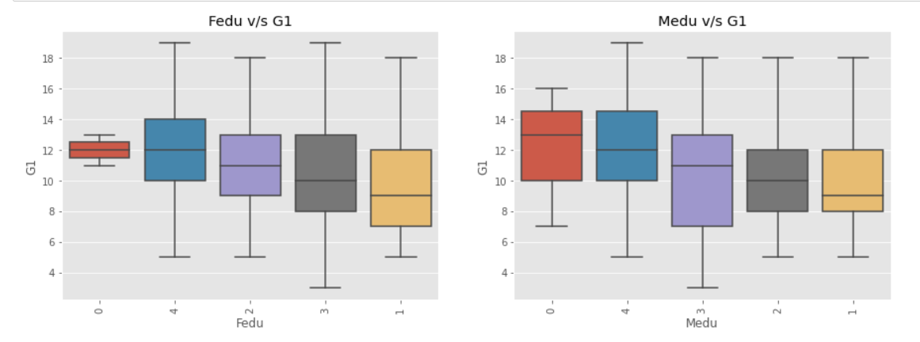
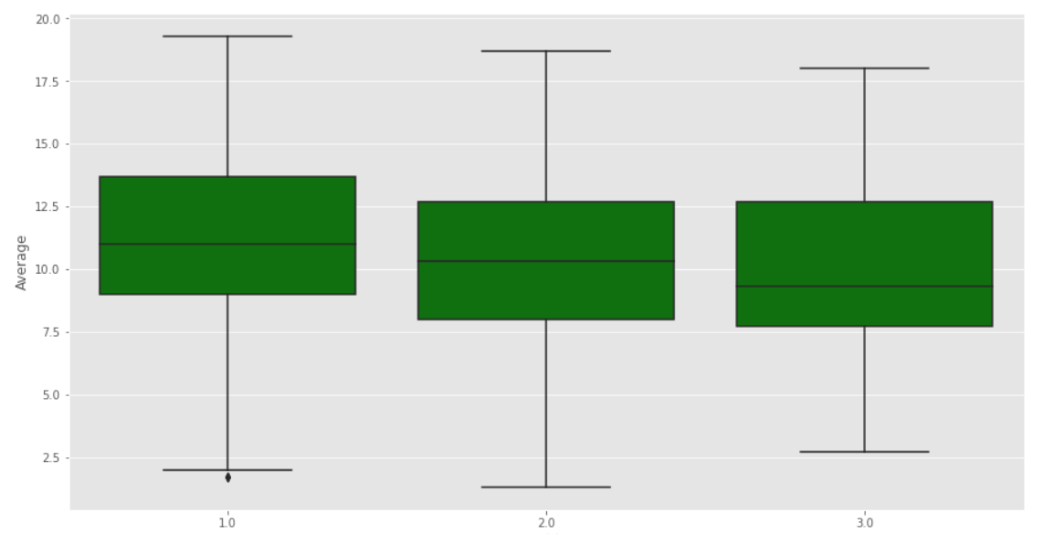
Age vs average marks
Grades decrease with age... but we notice that in the twenties it increases
Travel time vs grade average
yes ,the less travel time, the higher the demand for exam scores.
Mother and father education effect students grade?
yes , the more parents learn, the higher the student's grades

Slide 11
Conclusion
Students who study more score better on tests and quizzes and their failure rate decreases.
The more students want to enroll in higher education, the higher their average score in exams.
The higher the student's score in the first, second period grade and final grade , the higher the student's average score.
We notice in all exams that the scores of the students of School Gp are more than those of School MS

Slide 12
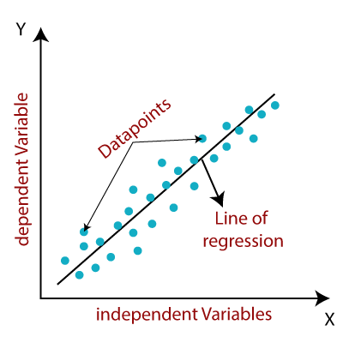
Performance prediction
Linear Regression
Regression algorithms are machine learning techniques for predicting continuous numerical values. They are
supervised learning tasks which means they require labelled training examples.
Linear regression attempts to fit a straight hyperplane to your dataset that is closest to all data points. It is most
suitable when there are linear relationships between the variables in the dataset.
Quick to compute and can be updated easily with new data
Relatively easy to understand and explain
Unable to learn complex relationships
Difficult to capture non-linear relationships

Slide 13
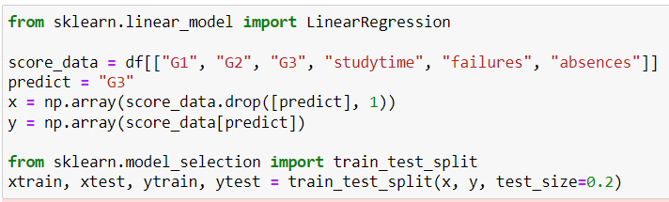
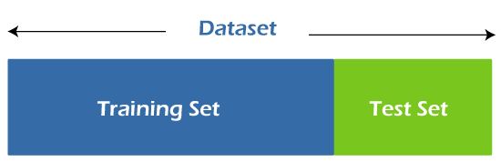

Splitting dataset and training model

Slide 14
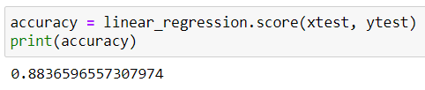
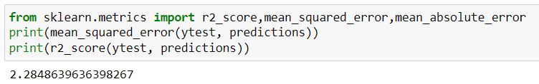

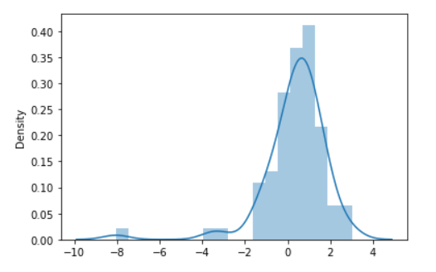
Evaluating prediction
Accuracy score
Mean square error
R2score
Residual plot

Slide 15
Thank you!!

